Slide 1


Slide 2


Slide 3
Introduction
XYZ Company, founded a few years ago, has been grappling with an attrition rate of around 15% over the past couple of years. This turnover
has impacted the company in several critical areas, including productivity, team morale, and overall operational costs.
The aim is to create a comprehensive dashboard that identifies key patterns and trends, offering the company a clear understanding of factors contributing to attrition. With this, XYZ Company can implement targeted interventions to improve employee retention and enhance organizational stability.

Slide 4

Process

Slide 5
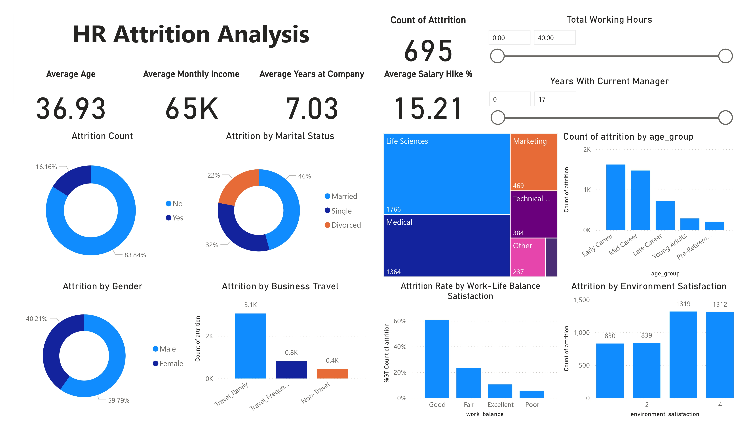

Slide 6
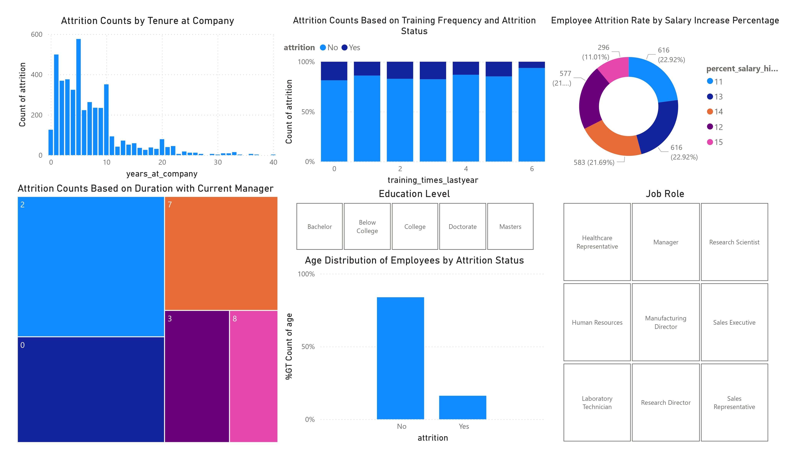

Slide 7
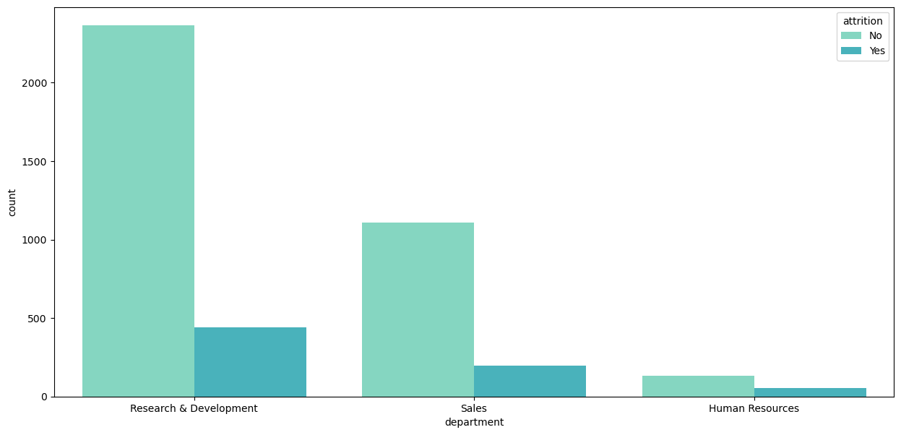
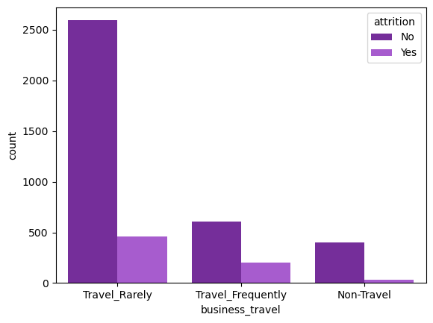
Insights
Attrition is more in R&D department, attrition is less in Human Resource department.
We can see that employees who travel rarely have more chance of leaving company compared to any field.

Slide 8
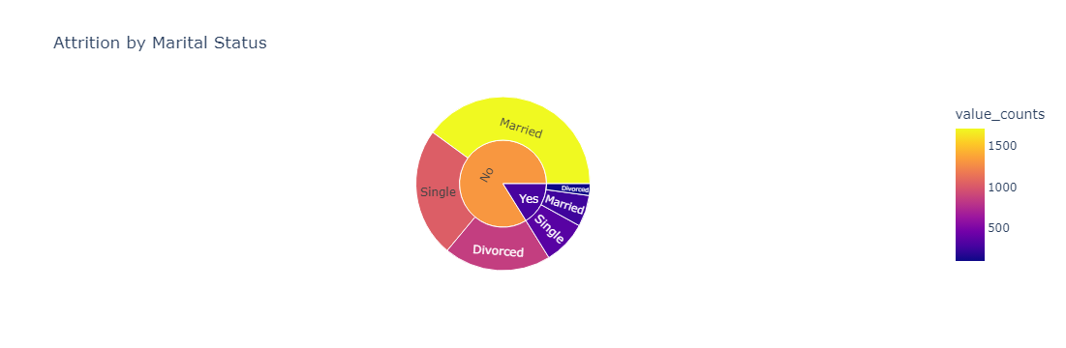
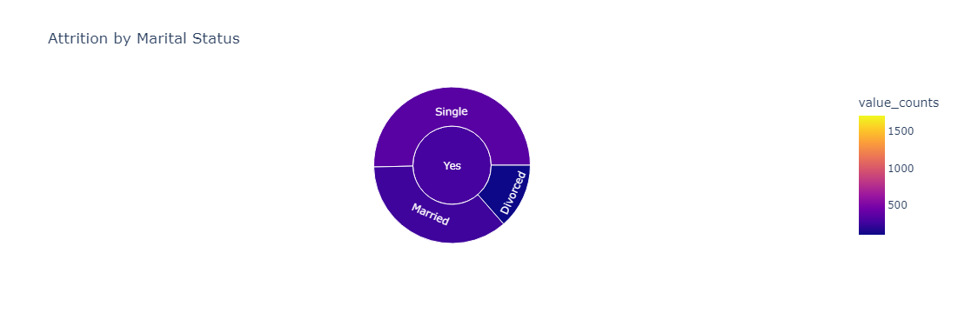
Insights
We can see that 695 employees left while 3605 stayed. Among those who left 350 were single, 251 were married, and 94 were divorced. Of the employees who stayed, 1718 were married, 1032 were single, and 855 were divorced. This shows that married employees are more likely to stay compared to single or divorced employees.

Slide 9
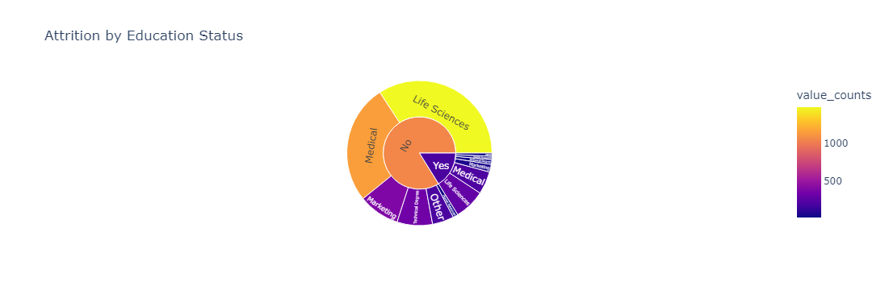
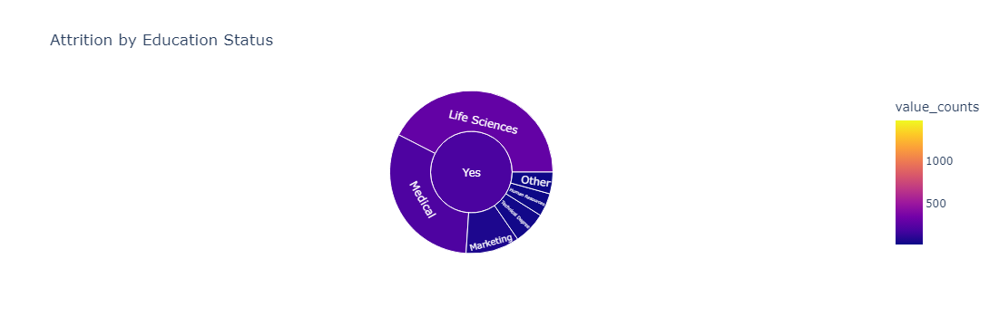
Insights
We can see that most of employees leaving the company are from Live sciences and Medical as their education status.

Slide 10
Summary
Total attrition count 695.
Average monthly income is 65K.
Company have total average of 7.03 as years at company, with attrition as yes it declines to 5.16 years.
Research and Development has most attrition count.
Employees who travel rarely leave company most.
Married employees are most likely to stay in company compared to divorced and single employees.
Employees with early career and mid career have most chances of leaving the company.
Most of them leave company at 0-1 years, and at 3-5 years.
Employees with Doctorate as education level has least or less chance of leaving company.
Employees with Good and Fair work balance have most chances of leaving company.

